Slide 1
Java-Technologies Overview
JVA-012

Slide 2
Contents
1
Introduction
2
Java Platform
3
J2SE Technologies
4
J2ME Technologies
5
J2EE Technologies
6
Related Technologies and Products

Slide 3
Seminar Goals
Main goals:
Acquaintance with the main java-technologies and products
Definition of main terms and interconnections between them

Slide 4
Target Audience
The seminar is oriented to
Everybody who needs brief java-technologies overview:
HR employees
Project managers
.NET developers
Specialists from non-contiguous areas

Slide 5

Introduction
Software architecture is a systems structure that contains:
software components
properties of these components visible from outside
relationship between them
Len Bass, Paul Clements and Rick Kazman (CMU SEI)
Software Architecture in Practice, 2nd Edition

Slide 6
Introduction
Basic architectures of information systems
The following dominated architectures of IS can be distinguished:
Stand-alone
Two-tier client/server
Three-tier client/server

Slide 7
Introduction
Stand-alone applications:
Are executed at the client working place
Single-use as a rule
Log in and log out – user

Slide 8
Introduction
2Tier Client/server
At such approach:
Client and Server parts are distinguished
Server – is an application that realizes business logics or access to data
All programs/clients work with one server

Slide 9
Introduction
2tier Client/Server
Using 2tier Client/Server:
Data are stored on server
Program-client realizes business logics

Slide 10
Introduction
2tier Client/server
Database server
Clients

Slide 11
Introduction
3tier client/server
Using 3tier client/server:
Business logics (application) is transferred to applications server
Three lays are distinguished at this:
Program - client
Applications server
Data servers

Slide 12
Introduction
3tier client/server
Applications server
Servers with data
Application
Clients

Slide 13
Agenda
Seminar plan
Introduction
Java platform
J2SE-technologies
J2ME-technologies
J2EE-technologies
Related technologies and products

Slide 14
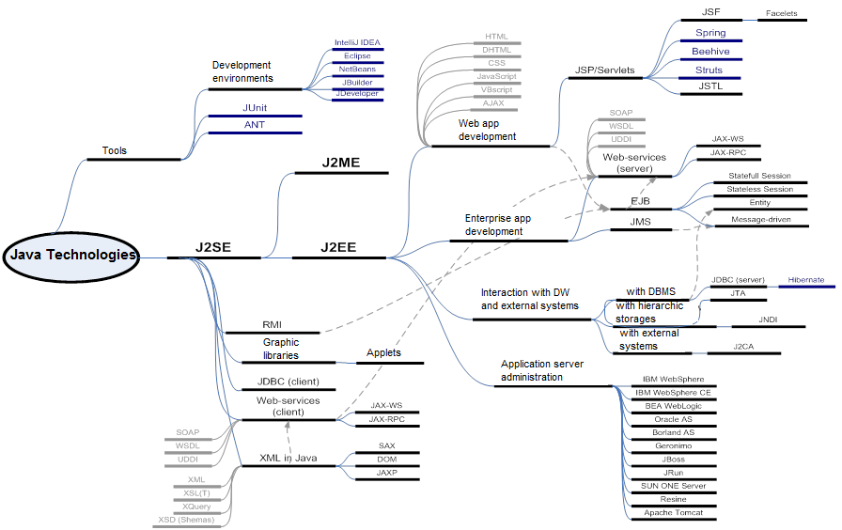
Agenda
Java-technologies map

Slide 15
Java platform
Java platform
Java – platform of development and execution of applications (programs)
The base is the programming language Java
Main principal – WORE (Write Once Run Everywhere)
That means total cross-platform transferability

Slide 16
Java platform
Java-applications transferability
To start java-application you need special software – Java Virtual Machine (JVM or JRE)
Java-application can be started at any program-hardware based platform for which JVM is written
http://java.com

Slide 17
Java Platform
Java-applications Transferability
Java-application
Can work on any platform where JVM is realized
Application server under
Unix
Working station under MAC OS
Handheld
Super computer
Working station under
Windows
Cell phone

Slide 18
Java Platform
Java editions
For different goals separate standards and set of libraries were developed – editions
The language in all editions is single
There are three editions:
J2SE (Java2 Standard Edition)
J2EE (Java2 Enterprise Edition)
J2ME (Java2 Micro Edition)

Slide 19
Java Platform
Conclusions of Java platform
Terms discussed:
Java platform
Transferability
Editions

Slide 20
Agenda
Seminar plan
Introduction
Java platform
J2SE-technologies
J2ME-technologies
J2EE-technologies
Related technologies and products

Slide 21
Agenda
Java-technologies map

Slide 22
J2SE
J2SE
The so called “core java”, is the core of the platform
The platform for development and start of applications on the client working places
J2SE standard describes Java language and minimum necessary set of system libraries

Slide 23
J2SE
J2SE
As a rule, J2SE-applications work on client servers

Slide 24
J2SE
Graphical libraries
Are the part of J2SE platform
Allow to develop java-programs with graphical users interface
Libraries in the order of importance:
JavaFX (new library)
Swing (the most popular, but abbadoned)
SWT (by IBM)
AWT (oldest, the least popular)

Slide 25
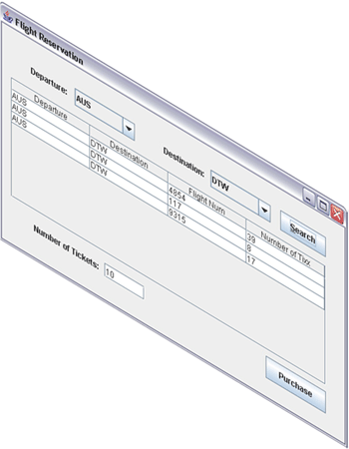
J2SE
Graphical libraries

Slide 26

J2SE
Applets
Java-applets – are the small programs with graphical interface that are integrated into HTML-pages
Visually applet looks like an area of HTML-page, in which java-program with graphical interface is executed

Slide 27
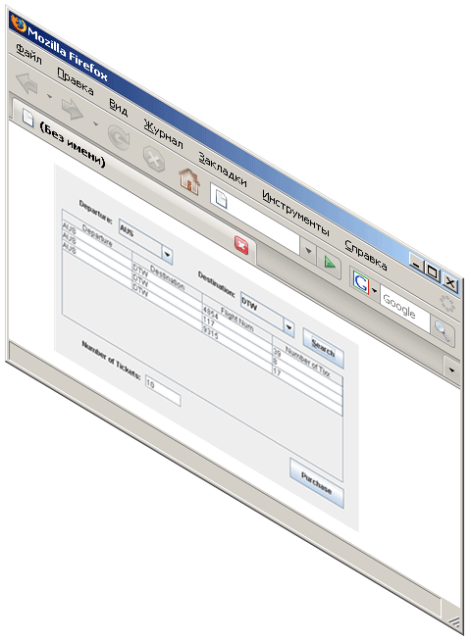
J2SE
Applets
Web-server
Browser
Applet

Slide 28
J2SE
JDBC (Java Database Connectivity)
Technology of access to DBMC from java-programs
JDBC is divided into client and server
JDBC client technology is used for writing “hard” program –clients that are executed on the user’s working places

Slide 29
J2SE
JDBC (client)
Java client program to DBMC (uses JDBC)
DBMC

Slide 30
J2SE
XML (Extensible Markup Language)
Independent from languages and platforms format of storing data
This format includes the following set of standards:
XML
XSL/XSLT/XSL-FO
XQuery
DTD
XSD (schemas)
data
<books>
<book>
<author>J Verne</author>
<title>20000 Leagues Under the Sea</title>
</book>
<book>
<author>K. Bulychev</author>
<title>A Girl Who Nothing Will Happen To</title>
</book>
</books>
transformation
structure

Slide 31
J2SE
XML in Java
XML-documents may be processed by a program written on any platform
For convenient work with XML-documents in java-programs the following standards are provided:
SAX
DOM
JAXP
JAXB

Slide 32
J2SE
XML in Java
Server program processing XML-documents
(uses SAX or DOM or JAXP)
Client program processing XML-documents
(uses SAX or DOM or JAXP)
XML
XML

Slide 33
J2SE
RMI (Remote Method Invocations)
RMI
Java-program
(uses RMI)
Java-program
(uses RMI)

Slide 34
J2SE
RMI (Remote Method Invocations)
Technology is the part of J2SE platform
Allows java-program at one computer to call java-program on another (via network)
In distinction from web-services is not so cross-platformed
RMI is actively used in EJB technology //will be covered later

Slide 35
J2SE
Web-services
UDDI-register
Client searches for the needed service in register
Web-service description is placed in UDDI-register
Client
Client calls for web-service using SOAP
Web-service
WSDL-description

Slide 36
J2SE
Web-services
Technology of calling the program on one computer by the program from another computer via network (remote call)
Is similar to RMI, but RMI is used only for java-programs, and web-services allow to call programs written on any language
RMI is not accessible via Internet, while Web services use World Wide Web for communication between program parts

Slide 37
J2SE
Web-services
Web-services technology is based on the family of xml-technologies
Web-service and its client may be written on any platform
For simplification of writing java-clients to web-services the following technologies are used:
JAX-RPC
JAX-WS
JSON

Slide 38
J2SE
Web-services
Web-service client written
on .NET
Web-service client written on Java (uses JAX-RPC
or JAX-WS or JSON)
Web-service written on…

Slide 39
J2SE
Web-services
Standards family includes:
SOAP information exchange standard
WSDL web-service description standard
UDDI web-services search and advertising standard

Slide 40
J2SE
Conclusions on J2SE
Discussed terms:
J2SE platform
Graphical libraries
Applets
JDBC (client)
XML in Java
Web-services (client)
RMI

Slide 41
Agenda
Seminar plan
Introduction
J2SE-technologies
J2ME-technologies
J2EE-technologies
Related technologies and products

Slide 42
Agenda
Java-technologies map

Slide 43
Mobile Java Platform
Java2 Micro Edition
J2ME – a set of libraries simplifying the development of java-applications for compact devices:
Cellular phones
Smartphones
Handhelds (PDA)
Plastic cards

Slide 44
J2ME
Java2 Micro Edition
Applications written for this platform are called MIDlets
MIDletes can work at the devices with the built-in JVM

Slide 45

Android OS
Android OS
Developed by Google for the line of mobile phones
The latest version of Android OS, as of year 2013, is 4.1
Applications are developed with Java language
Android OS is not compatible with J2ME
At the moment, Android OS is a leader on mobile platform market

Slide 46
Mobile Java Platform
J2ME platform
MIDlets
Android OS

Slide 47
Agenda
Seminar plan
Introduction
J2SE-technologies
J2ME-technologies
J2EE-technologies
Related technologies and products

Slide 48
Agenda
Java-technologies map

Slide 49
J2EE
Java2 Enterprise Edition
J2EE – is a set of standards and libraries simplifying the development of server applications

Slide 50
J2EE
Applications server
Written by a developer server applications work on a special application server or J2EE-server
J2EE-server – is a specialized program that manages components, ensures data exchange and resolves security issues

Slide 51
J2EE
Applications servers
There are a lot of J2EE-servers producers
Standard J2EE-application can work at any of them as all applications servers are unified for applications
Servers differ from each other by a set of characteristics

Slide 52
J2EE
Applications servers
The most popular servers:
BEA WebLogic
IBM WebSphere
Oracle AS (OC4J)
Resin
Wildfly (fomely JBoss AS)
IBM WebSphere CE
Apache Tomcat/TomEE
GlassFish
Jetty
Apache Geronimo
Complicated popular expensive servers
Inexpensive popular server
Popular free servers

Slide 53
J2EE
Applications servers
J2EE-developers do not need to know the details of administrating the concrete J2EE-servers
But very often the developers need to administer the server also so knowledge of administrative details is undoubtedly an advantage

Slide 54
Agenda
Java-technologies map

Slide 55
World Wide Web
Web server
Browser

Slide 56
J2EE
Web-applications
J2EE web-applications work at applications server and process users requests via web-interface
Web-interface is a set of HTML-pages. To view them on the client computer only web-browser is necessary

Slide 57
J2EE
Web-technologies
J2EE-application can execute difficult actions (business-logics) and the result is sent to client in HTML-pages
J2EE web-developer from one side should know how to write J2EE application and from another – web-technologies

Slide 58
J2EE
Web-applications
front-office
(HTML, CSS, JavaScript,AJAX)
back-office
(JEE/frameworks + access to data technologies)
J2EE web-application (executes business logics and sends the result in HTML-pages)
Data servers
Program-client – simple browser

Slide 59
J2EE
Web-technologies
A set of technologies that should know web- developer on any platform:
HTML | Necessary
CSS | Desirable/Knowledge about some CSS frameworks
JavaScript | Necessary

Slide 60
J2EE
JSP/Servlets and additional technologies
Basic technology of developing J2EE web-applications – is Servlets
To simplify the development of web-applications “above” Servlets there are additional standard Oracle technologies:
JSTL | Desirable to know
JSF (Java Server Faces) / Facelets | As advantage

Slide 61
J2EE
Additional technologies
Besides the standard Oracle – technologies there are very popular libraries written by enthusiasts :
Spring framework | Necessary
GWT (Vaadin) | Desirable
Apache Wicket | Desirable

Slide 62
Agenda
Java-technologies map

Slide 63
J2EE
Business-applications
Business applications in J2EE – is a set of programs executing business logics, receiving data from client and sending him back the result
In contrast to web-applications, business applications do not send web-pages to the user. Instead, they only send essential data

Slide 64
J2EE
Business applications
To run such application the user’s computer should have program-client for that application
This program-client:
Receives data from the user (graphical or textual interface)
Sends data to business-application (via RMI or web-services)
Application sends the result back to client

Slide 65
J2EE
Business applications
RMI or web-service
J2EE business application
Program-client

Slide 66
J2EE
Business application types
J2EE specification allows to develop the following types of corporate applications:
Enterprise JavaBeans (EJB)
CDI Beans
Java Messaging Service (JMS)
Web-services

Slide 67
J2EE
EJB (Enterprise JavaBeans)
EJB – non-visual business applications
EJB types:
Message-driven (MDB) | The simplest EJB type. It is necessary to know JMS technology
Stateless Session (StlsS EJB) | Comparatively simple types.
Stateful Session (StflS EJB) | The most difficult EJB type. It is necessary to know JDBC/JPA Excluded from EJB3 standard
Entity

Slide 68
J2EE
JMS (Java Messaging Service)
JMS technology allows the clients, web-applications and business applications to exchange messages
JMS looks like an ordinary e-mail but with the stress on speed and reliability of messages delivery

Slide 69
J2EE
Web-servers (server)
Web-service development comes down to:
Business logics development
Advertising it as web-service
The core of web-service (business logics) in J2EE may be:
Independent java-program
EJB-application
JMS-application

Slide 70
J2EE
Business applications
EJB client
JMS-client
RMI or SOAP
EJB
RMI
JMS
Web-service
SOAP
Web-service client

Slide 71
Agenda
Java-technologies map

Slide 72
J2EE
Interaction with external systems
External systems may be of the following types:
Data warehouses:
DBMS
Hierarchic storages
External CIS

Slide 73
J2EE
Interaction with DBMC (server)
For interaction with DBMC form server applications the server technology JDBC is used

Slide 74
J2EE
Interaction with DBMC (server)
Server technology JDBC is used
Client technology JDBC is used

Slide 75
J2EE
Interaction with DBMC
JDBC – is rather a low-level technology
For simplification of development and support of applications working with DB there is a number of standards and libraries

Slide 76
J2EE
Interaction with DBMC
The most popular:
Entity EJB | Standard business components type in J2EE. standard. Hard for learning technology. Outdated
JPA | Industrial standard that took the place of Entity EJB.
Hibernate | Open source library developed by community. Is implementation of JPA but could be used as independent library.

Slide 77
J2EE
Interaction with DBMC
One more standard technology realized by applications server (as JDBC)– is JTA
Java Transaction API allows the applications without disturbing entirety change the data on several data sources (DBMS, CIS, JMS)
JTA knowledge is very desirable

Slide 78
J2EE
Interaction with DBMC, conclusions
Server technology JDBC is used
Server technology JDBC is used and Hibernate library
Client technology JDBC is used
Client JDBC technology is used and Hibernate library

Slide 79
J2EE
Interaction with hierarchic storages
Hierarchic (or tree-structured) storages use tree-structured data presentation
Sometimes they are called LDAP-servers
Typical representatives:
Microsoft Active Directory
Novell Directory Service
Sun ONE Directory Service

Slide 80
J2EE
Interaction with hierarchic storages
Hierarchic (or tree-structured) are available in java-applications via standard technology JNDI
Developer for access to such external service should know accordingly :
LDAP standard
JNDI standard

Slide 81
J2EE
Interaction with external hierarchal storages, conclusions
LDAP-servers
LDAP and JNDI are used
LDAP and JNDI are used

Slide 82
J2EE
Interaction with hierarchic storages
J2EE-developer should know JNDI technology, even if the application does not use external hierarchic service
It is because inside J2EE-server works built-in hierarchic service that applications often refer to

Slide 83
J2EE
Interaction with External CIS
External CIS– Corporate Informational Systems installed in organization
For their availability from server applications Java2 Connector Architecture (J2CA) is used
This technology is not of a great need

Slide 84
Agenda
Java-technologies map

Slide 85
J2EE
Conclusions on J2EE
Discussed terms:
J2EE platform
Applications server
Web-applications
Business applications
Access to data from server applications

Slide 86
Agenda
Seminar plan
Introduction
J2SE-technologies
J2ME-technologies
J2EE-technologies
Related technologies and products

Slide 87
Agenda
Java-technologies map

Slide 88
Related Technologies
Tool set
Development tool set includes:
Development environment
Assembly tool
Module testing library

Slide 89
Related Technologies
Development environment
The most popular development environments are:
Eclipse
NetBeans
Oracle JDeveloper
JetBrains IntelliJ IDEA
Borland JBuilder
Free
commercial

Slide 90
Related Technologies
Assembly tool
Assembly tool – is a program that automates routine tasks at application development
The de-facto standard are free products ANT (Ivy) and Maven

Slide 91
Related Technologies
Module testing library
Testing – is a necessary stage in software development
Developers often use module testing
For automation of module testing there are special libraries
The de-facto standard are free libraries Junit and TestNG

Slide 92
Java-Technologies
Conclusions on related technologies
Discussed terms:
Development environment
Assembly tool
Testing library

Slide 93
Java-Technologies
Conclusions to seminar
Discussed themes:
Introduction
J2SE-technologies
J2ME-technologies
J2EE-technologies
Related technologies and products

Slide 94
De-facto Java Standards
Spring is a whole product family released under such trademarks as SpringSource and VMWare:
Spring Framework core is a popular development framework. In most cases, it can substitute EJB;
Google Web Toolkit (GWT) is a AJAX-based approach to web-oriented UI development. In it’s foundation lays the idea: “Write in Java, run in JavaScript”

Slide 95
Conclusions to seminar
Java-technologies map

Slide 97
Appendix
Specialists certification process
Many vendors provide certification mechanism
Specialists certification helps to evaluate his knowledge objectively
Certification process includes an examination, if it is passed the specialist gets the status

Slide 98
Appendix
Oracle Certification
Oracle Java Web Component Developer
Oracle Mobile Application Developer
Oracle Developer Java Web-services Developer
Oracle Business Component Developer
Oracle Java Certified Programmer

Slide 99
Appendix
Java Champion – community driven title (not certificate) for most valuable developers

